Slide 1



Explore India
DATA VISUALIZATION USING PYTHON
Tourism Analytics & Smart Trip Planner
Addya Nagle
Siddhi Singh
Karan Toraskar
Hrugved Bhoite
Aditya Gudage
PRN 1262242243
PRN [1262242131]
PRN [1262242004]
PRN [1262242079]
PRN [1262241948]
Notes:
Student 1 (about 2 min for slides 1-2). Welcome. Introduce our mini project, Explore India, for Data Visualization Using Python, and the members named on the cover. Then move to the problem statement.

Slide 2






Problem statement and objectives
Tourism information about India is spread across many sources, which makes it hard to compare destinations and plan a trip from data.
Objective 1
Objective 2
Objective 3
Analyse a tourism dataset to find patterns across destinations.
Present findings through interactive Plotly visualisations and a dashboard.
Turn the analysis into a smart trip planner that supports travel decisions.
Notes:
Student 1. Our project answers one question: how can tourism data help a traveller choose and plan a trip? State the problem and the three objectives in your own words. Transition: Student 2 will describe the dataset and how we prepared it.

Slide 3



Dataset description and preprocessing
Dataset description
Preprocessing tasks
Loaded for use
Source: [Kaggle link or authentic source].
Fields: attraction name, type, location (city, state), rating, reviews (lakhs), entry fee, visit duration, best time to visit.
Missing values:
Entry fee ("Free" vs amounts):
Dropping unwanted columns
No duplicate data
Cleaned data is imported into a SQLite database so the website reads it through the backend.
Notes:
Student 2 (about 3 min for slides 3-4). Name the real dataset source and size. Explain each preprocessing step actually performed; fill in the bracketed items first. Transition: now how the cleaned data reaches the website.

Slide 4






Frontend, backend and data connectivity
Dataset
SQLite
Flask
Plotly
Website
cleaned data
schema + import
APIs + queries
charts
pages + planner
Frontend
Backend and data connectivity
Website pages
(Home, Destinations, Trip planner, Insights, Travel quiz, Saved, Trip History)
Built with
HTML,CSS and JavaScript, with Plotly charts.
Flask APIs and logic query the SQLite database, so every page reads from one connected data source.
Notes:
Student 3 (about 1.5 min). Walk the flow left to right, then describe the frontend and the backend. Stress data connectivity: one database, read through the Flask backend by every page. Transition: here is everything the website offers.

Slide 5
Website features
Home
Destinations
Trip planner
Saved
Landing page and overview.
Browse attractions with rating, reviews and entry fee
Builds an itinerary from budget and available time
Places saved to a personal collection
Trip History
Plan a trip
Insights
Travel quiz
Saved itineraries to view, edit or delete
Shortcut button to start planning
Charts of attractions by state and type
[Short quiz that describes the travller you are ]
Notes:
Student 3. Walk through the navigation bar of the website, one feature at a time, and fill in the Home and Travel quiz descriptions. Transition: we now show the visualisations and what they tell us.

Slide 6
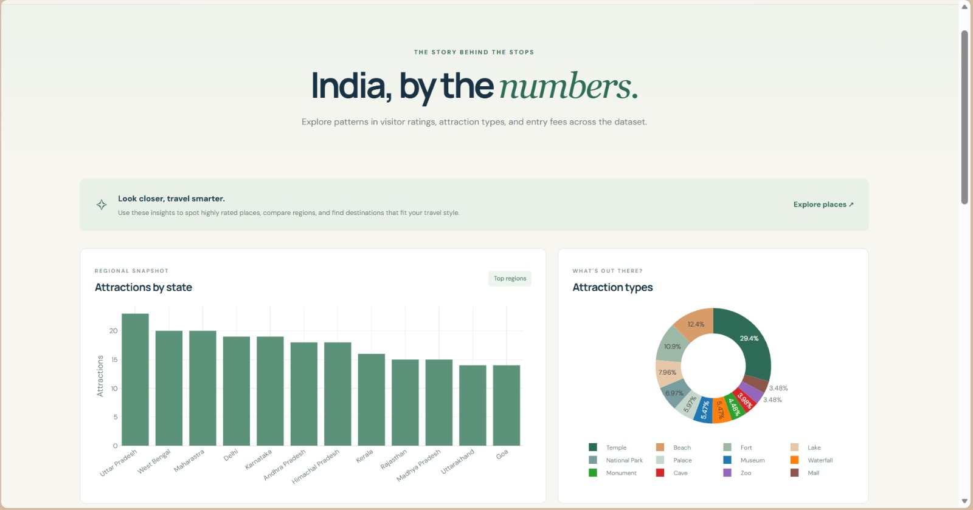
Insights: where to go
How it helps
• Shows how attractions are spread across states, so travellers see where choices are richest.
• Shows the mix of attraction types, so a trip can be matched to personal interests.
• Charts are drawn from the same connected database as the rest of the site.
Notes:
Student 3 (about 3 min for slides 6-7). Show the Insights page as an example of what the website gives a traveller. Explain the purpose of each chart, not individual data points. Transition: next, comparing destinations.

Slide 7
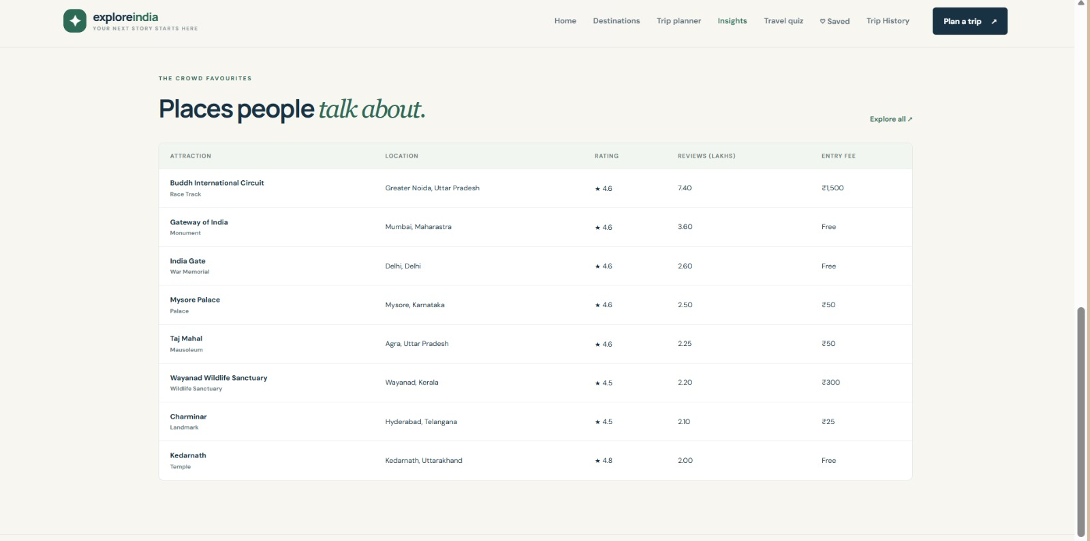
Destinations: comparing places
How it helps
• Lists attractions with location, rating, reviews and entry fee in one table.
• Ratings and review counts show how popular a place is.
• Entry fees help travellers judge cost before they plan.
Notes:
Student 3. Show the Destinations page as an example. Explain how a traveller uses it to compare places and shortlist them. Transition: Student 4 will show the trip planner.

Slide 8
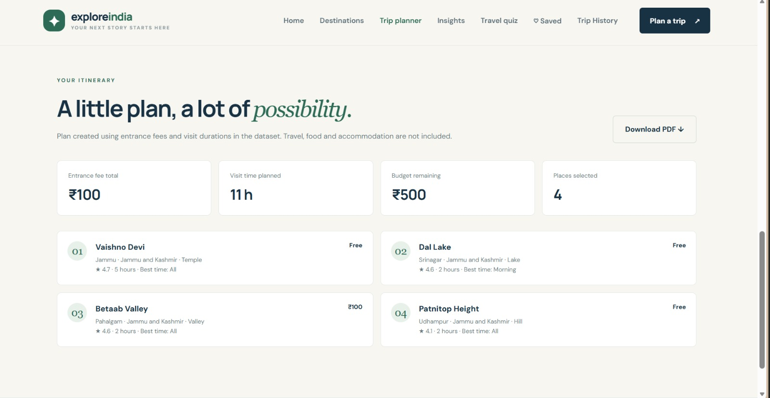
Trip planner: building an itinerary
How it helps
• Traveller sets a budget and available time.
• The planner selects places and adds up entrance fees and visit time.
• Shows budget remaining and places selected, and the itinerary can be downloaded as a PDF.
Notes:
Student 4 (about 3 min for slides 8-9). Demonstrate the planner as the core feature: input budget and time, show the generated itinerary and summary, then the PDF download. Transition: saved places and trip history.

Slide 9
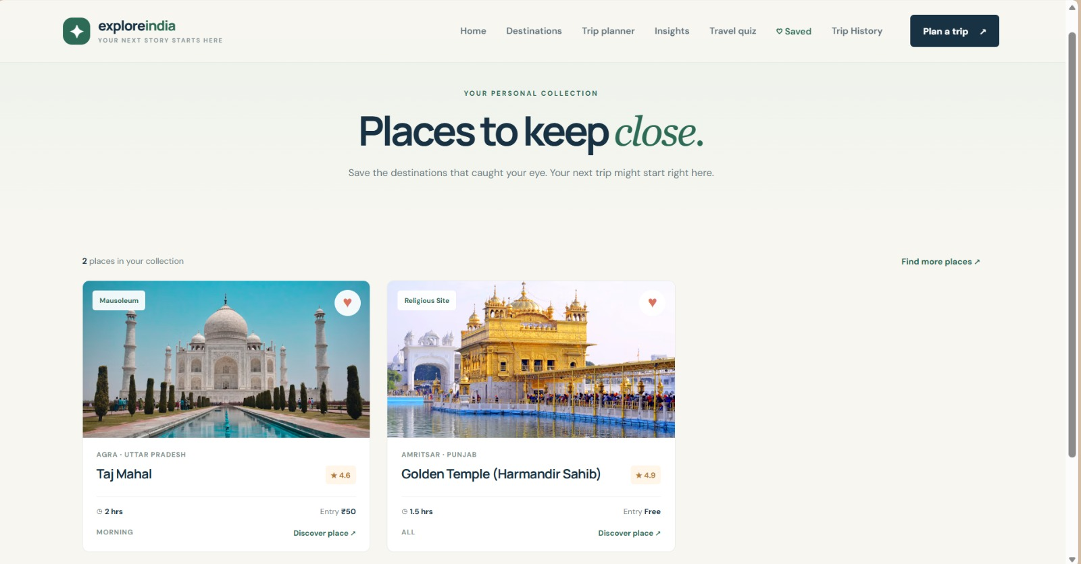
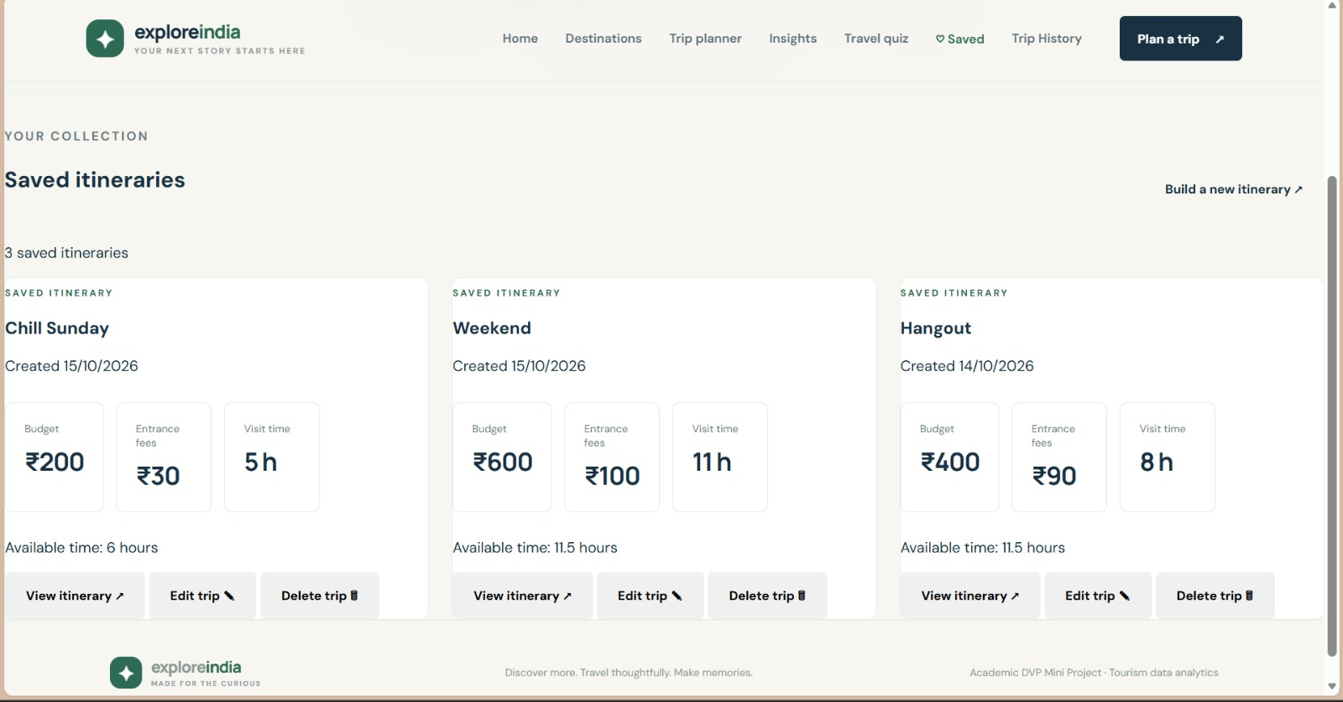
Saved places and trip history
Saved: keep the places you like in a personal collection to revisit later.
Trip History: store planned itineraries and view, edit or delete them later.
Notes:
Student 4. Show the Saved page and the Trip History page. Explain that they let a traveller keep shortlisted places and reuse planned itineraries. Transition: Student 5 will conclude.

Slide 10

Backend in depth: request flow
Browser
Flask routes
Logic
SQLite
JSON
page request
validate input
plan, aggregate, save
SQL queries
response to page
Routes
Business logic
Data layer
Each website page calls a Flask route. Routes read the request, check inputs and return JSON.
Python functions handle the trip-planner rules, insight aggregation, and saving, editing and deleting.
SQL queries run through one shared database connection used by every route.
Notes:
Student 3 (about 3 min for slides 10-12). Explain the request path: a page asks a Flask route, the route calls the logic, the logic queries SQLite, and JSON goes back to the page. Fill in the confirmed details from the code. Transition: the database design.

Slide 11
Backend in depth: database design
Attractions
Saved places
Saved itineraries
• name and type
• reference to an attraction
• trip name
• city and state
• added when the heart is tapped
• created date
• rating
• removed when un-saved
• budget and available time
• reviews (lakhs)
• entrance fees and visit time
• entry fee
• places selected
• visit duration
• best time to visit
Notes:
Student 3. Describe the SQLite schema: the attractions table imported from the cleaned dataset, and the tables that support Saved and Trip History. Correct the column lists to match the real schema. Transition: the APIs and the planner logic.

Slide 12
Backend in depth: APIs and planner logic
Destinations
Planner logic [confirm rule]
list and filter attractions with rating, reviews and fee
• 1. Read the traveller's budget and available time.
• 2. Choose places so total entrance fees stay within budget and total visit time fits the available time.
Insights
counts by state and by type for the charts
• 3. Return fees total, time used, budget remaining and places selected.
Planner
• 4. Export the result as a PDF.
build an itinerary from budget and time
Saved
add or remove saved places
Trip history
create, view, edit and delete itineraries
Notes:
Student 3. Walk through the API groups, one per website feature, then the planner logic step by step. State the exact selection rule used in the code. Transition: Student 5 will conclude.

Slide 13

Conclusion and documentation
Conclusion
Documentation
Explore India turns a tourism dataset into insight charts, destination browsing, a trip planner and saved trips in one connected website.
Project report, this presentation, and visualisation / .ipynb files.
Dataset source: [].
Code repository: [].
Notes:
Student 5 (about 1 min). Summarise what the project delivers and list the documentation submitted. Then hand over to the thank-you slide.

Slide 14
Thank you
Notes:
Student 5. Thank the faculty and invite questions.

